Slide 1
0x408 – Identifying Functions
ECED4406 – Computer Security
Dr. Colin O’Flynn
Dalhousie University.

Slide 2
Ghidra Needed!
The following will make more sense once you are hands on with Ghidra

Slide 3
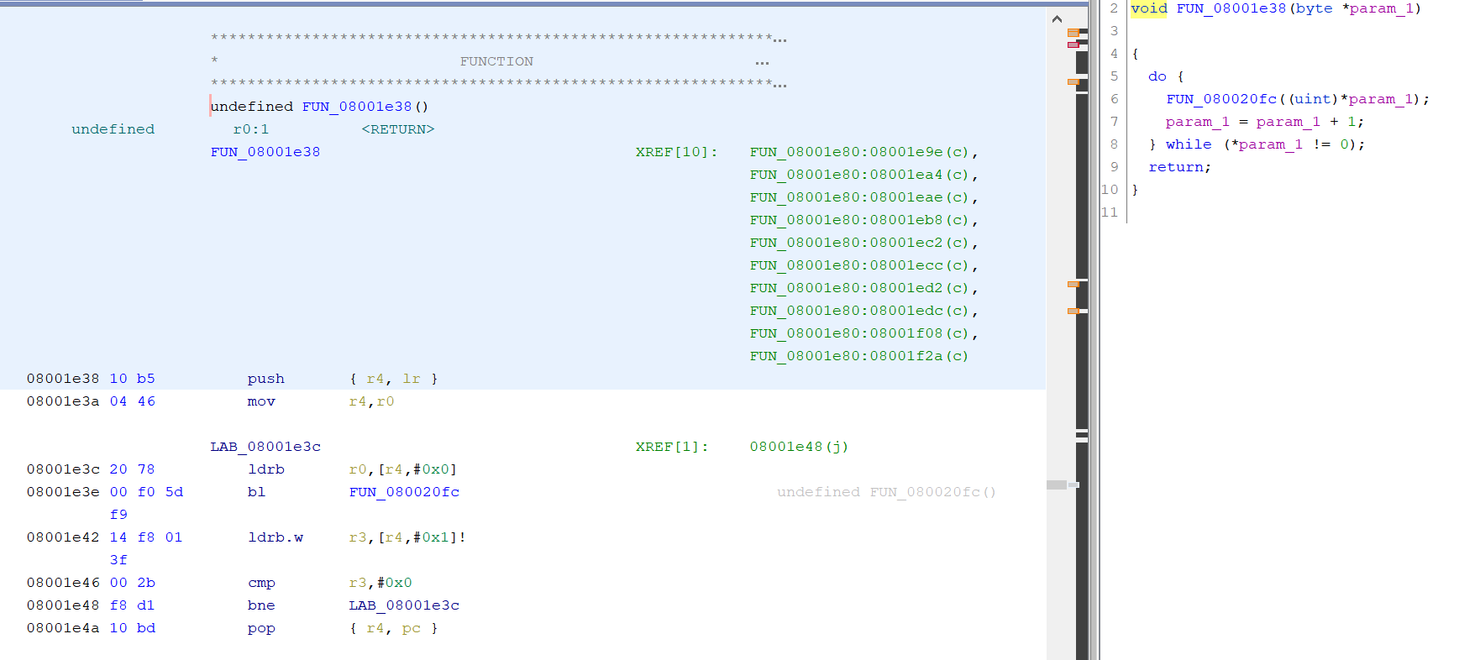
Example: What is this function?

Slide 4
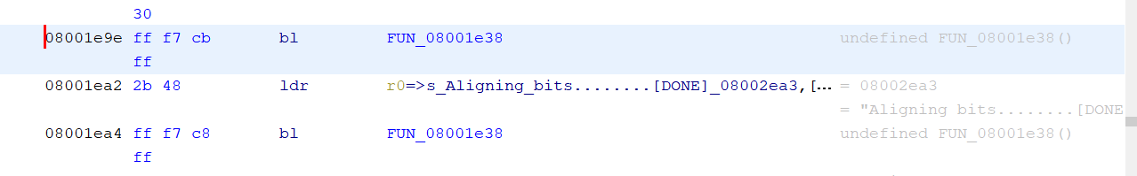
Hint #1: Looking at Calls to the Function

Slide 5
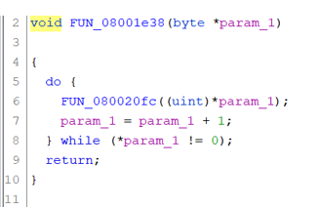
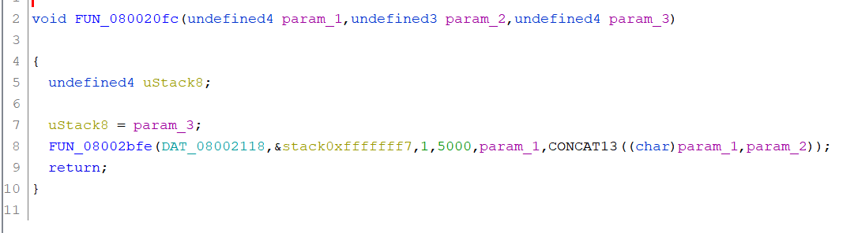
Hint #2: Following Function “Down”
What is this??

Slide 6
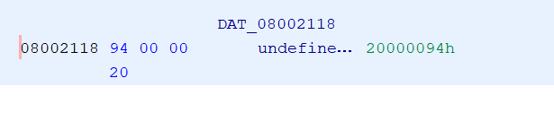
Following DATs
This is in RAM in the target, but Ghidra doesn’t know that!

Slide 7
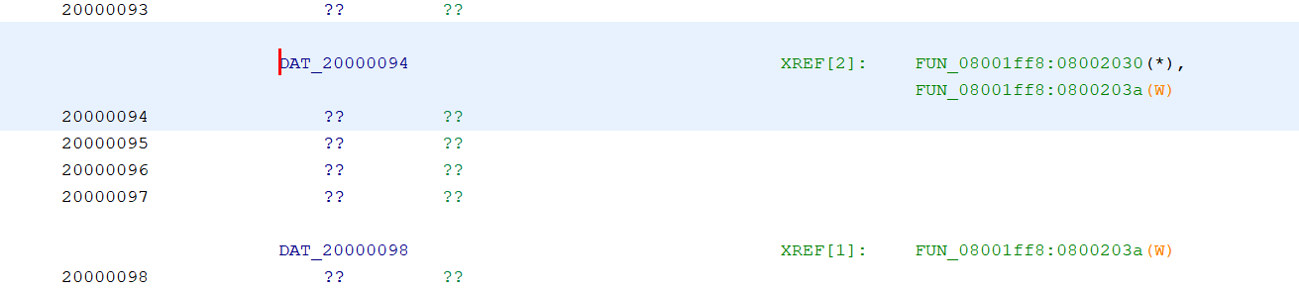
Using XREFs
If we set up memory map correctly (to be done in Lab #1), we can more easily find references to all of these variables:
Name doesn’t make sense?

Slide 8
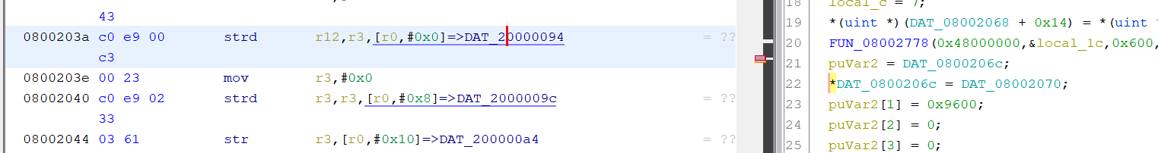
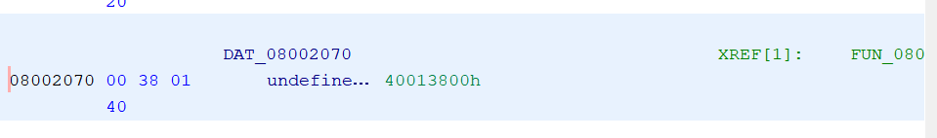
More confusing notations!
It can be hard to follow all the DAT_xxxx – you can rename variables to something sensible.

Slide 9
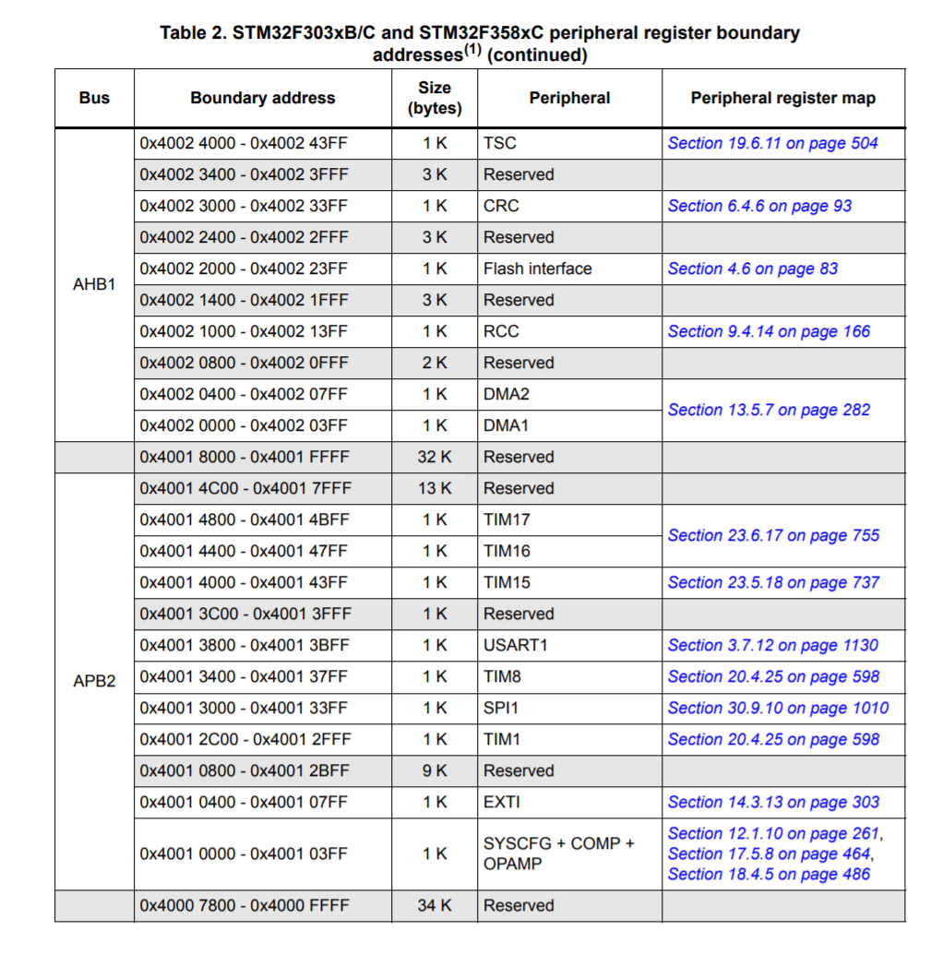
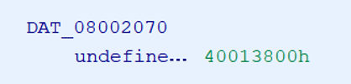
Peripheral Registers / Memory Map

Slide 10
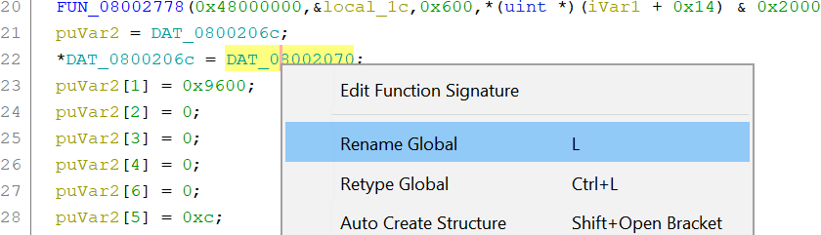
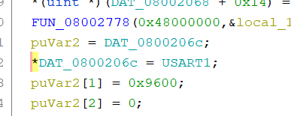
Rename as USART1
…This just holds USART1’s address??

Slide 11
Figuring out PUTS
The variable at address 20000094 is loaded with USART0’s address.
Thus the function we looked at earlier, which had some sort of loop running over input data, also was connected to USART0.
…most likely some sort of “printing” function.

Slide 12
Cortex-M Specific Function Help
We can use something called SVD files to automatically load the peripheral addresses.
Released as a tool thanks to Thomas Roth (posts the ‘Ghidra Ninja’ tutorials).
Makes this work much easier!
Other ways of identifying functions, such as detecting “known” function signatures.
This doesn’t work as well on Cortex-M/embedded compared to desktop applications.
Often tracing strings is one of the most useful ways! Finding a string used in a function can tell you a lot about what it does…

